Slide 1
Concepts of Biology Biol 111 Minot State University
Lecture, MWF 12:00-12:50 pm
Cyril Moore Science Center, Room 16
Lab, Tuesdays/Thursdays
Swain Hall, Room 304

Slide 2
Lecture 32 April 25, 2018
Announcements—
Will get Exam 4 back in lab next week. We will go over them next Friday after they are returned.
This week’s lab---an evolution board game. You choose your traits. Amazingly fun and helps us understand natural selection!

Slide 3
Where were we?...
We learned the 2 steps of decoding a gene.
We had begun to think how a little change in a gene, might make a little change in a protein, and that that is the source of variation in living things!

Slide 4
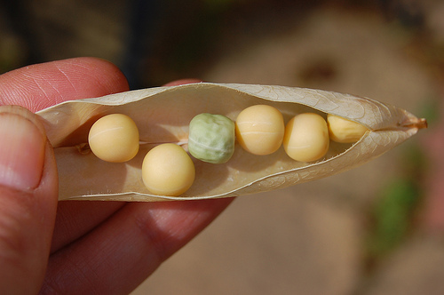

Slide 5
For example…consider the following… Pretend this little gene controls pea shape
AUG/UCG/CUU/CAA/GAA/GCA/GCA/ACA/UAA
met- ser- leu- gln- glu- ala- ala- thr
What if a mutation occurred here?
A substitution of one nucleotide for another is known as a point mutation. Other types of DNA changes occur---stay tuned.

Slide 6
Oops! Thanks Jessica!
AUG/UCG/CUU/CAA/GAC/GCA/GCA/ACA/UAA
met- ser- leu- gln- asp- ala- ala- thr
The new amino acid sequence might make the protein different enough to produce the wrinkling we see.

Slide 7
Now there are 2 different versions of a gene that affects the shape of peas.
What do we call different versions of the same gene?
Alleles! Alleles encode different versions of the same protein, to produce variation among individuals in a population.

Slide 8
Some of you have blue (non-pigmented) eyes and some of you have pigmented eyes due to variation in one gene. The gene encodes a protein that controls the production of pigment in the eye!
Your book describes alleles using an example observed in corn kernels. These alleles arose due to a different kind of mutation (not a point mutation), but illustrate the same idea.

Slide 9
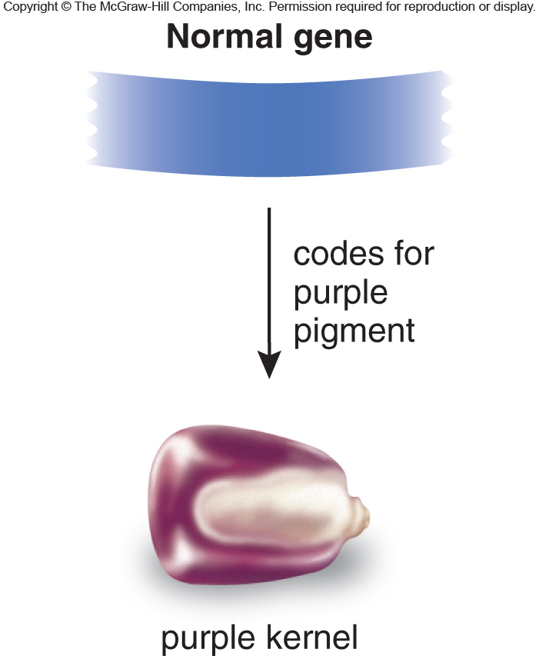
Fig. 11.18a

Slide 10
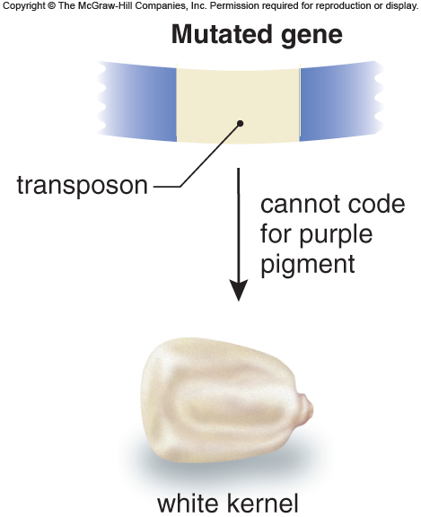
Fig. 11.18b

Slide 11
Connecting genetics to evolution
These small changes in genes provide variation in individuals in a population. Some variation may help these individuals survive. If they survive they potentially reproduce and pass that form of the trait to offspring…After time we may see populations shift and after a long time we may see creatures that resemble the original creatures, but have new/different traits…a different species.

Slide 12
Human example?...
Over the last 2-3 million years, humans had small variations in skull shape.
Some variation was due to different alleles of genes controlling skull development or shape.
If a specific feature (like jaw shape) helped individuals to survive they reproduced and passed those alleles to their offspring.

Slide 13
Variation in skull design in humans

Slide 14
Modern humans evolved a larger brain space and less developed jaw.
Modern apes retain the jaw design to survive in their environment.

Slide 15
Modern Genetics
Since we know so much about how genes work---can we apply that information to change genes?
For example, could we change a gene alteration that causes a disease?
Can we control genes that give an organism a better chance of survival?
In some cases yes!

Slide 16
Biotechnology/Molecular Genetics
I started out discussing gene expression by saying that experiments from the 1950s through the 1980s really showed us how this all works.
Much research from the 1980s through today has focused on applying genetic mechanisms to benefit humans, and the living world.

Slide 17
Recall…the code is universal
That means any gene, from any organism, is expected to be expressed the same way in another organism.
We’ve taken advantage of this in the development of recombinant DNA technology.

Slide 18
Recombinant refers to the idea that we can cut and paste DNA from different organisms together AND that we put DNA from one organism into another.
We can recombine genetic material---human insulin can be made cheaply and efficiently by bacteria---people with type I diabetes use recombinant insulin. ☺

Slide 19
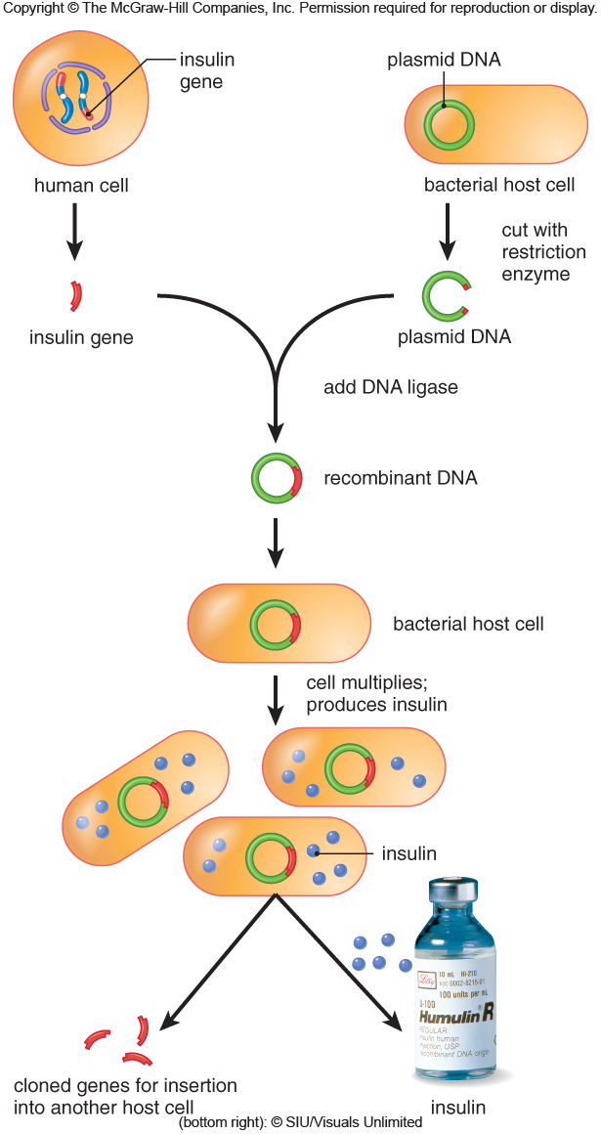
Fig. 11.19

Slide 20
Scientists have made modifications to other organisms by adding genes to their normal complement of genes.
When a gene from another organism is added, we call this a transgenic organism. (The insulin-producing bacteria are one example)

Slide 21
Examples?..
Bacteria with added genes to make them able to digest envronmental waste.
Fish with added growth genes make them bigger faster
Crop plants with added genes can withstand cold temps, weeds, or treatment with chemicals.

Slide 22
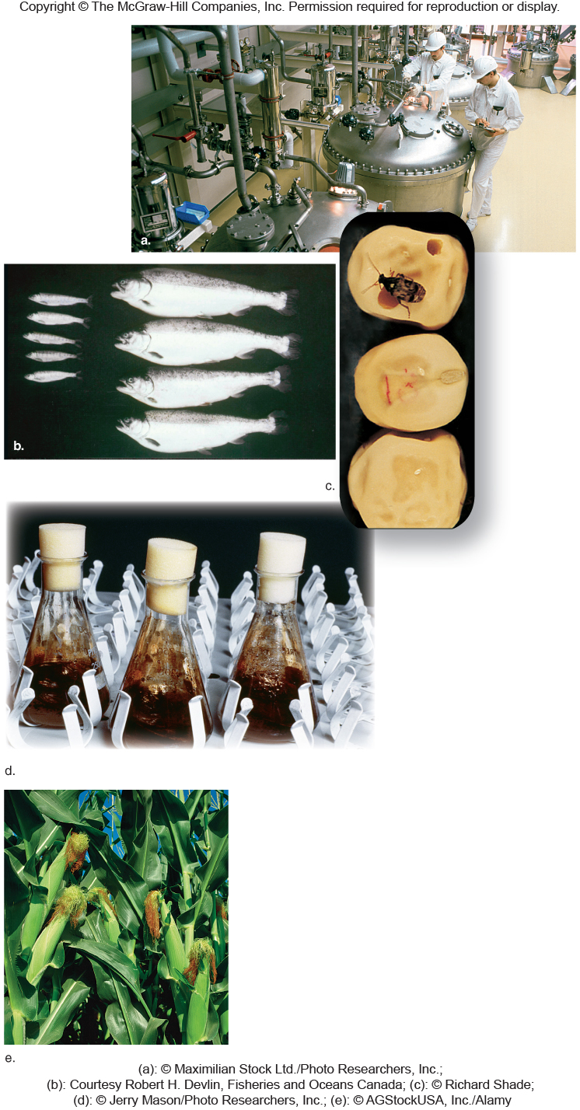
GMOs

Slide 23
The US stands somewhat alone in the world embracing GMOs. Much of Europe bans GMOs Why? Fake news? Valid concerns?

Slide 24
Be informed—use your head!
Some GMOs allow indiscriminant use of pesticides/herbicides on crops—”Roundup Ready”
Developers of GMOs retain control so that farmers are forced to pay for seed every year. BIG MONEY industry
Genes can spread to crops/weeds that we did not intend to have the transgene.
Long-term testing (human consumption) not yet available.
GMOs Usually have a single protein not in the original organism.
Protein not “manmade” or toxic
Some GMOs include nutrition not in the natural product
Increased yields help feed the planet
Products tested for safety and nutrition

Slide 25
Basic info…Read more! Not Fake news!
https://www.livescience.com/40895-gmo-facts.html

Slide 26
CRISPR-CAS9 gene editing
One of the most exciting techniques for studying genes is a system used in nature by bacteria called CRISPR or CRISPR-CAS9
It allows scientists to target single genes and remove/destroy or change them in a cell or embryo.

Slide 27
Why?
Removing a gene’s protein product allows us to understand its importance and its role.
Traditionally this has been done by gene “knock out” techniques in mice—This has been powerful, but can take years to develop the mice.
CRISPER technology being expanded to change genes---to possibly repair disease-associated mutations.

Slide 28
Why is CRISPER somewhat controversial?

Slide 29
Where have we been this semester? Connecting concepts….
From atoms to molecules to cells to organisms to populations of organisms…and finally to thinking about the source of diversity of life.
Biodiversity reflects genetic diversity---and you are now experts at genetics and gene expression!

Slide 30
Months ago we defined life and discussed a point in time where molecules organized into a primitive cell. (about 3.5 billion years ago)
This, we would consider the ultimate common ancestor!

Slide 31
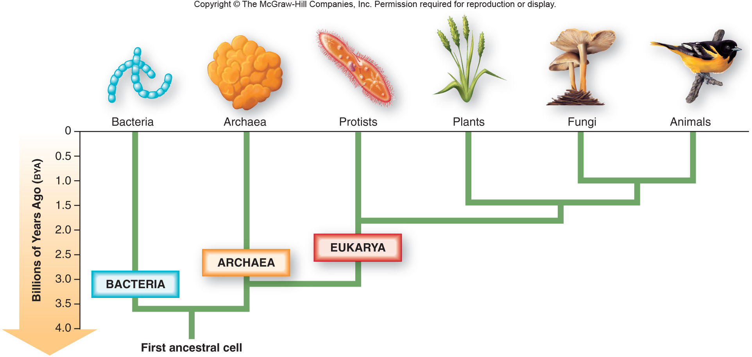
Fig. 1.4
Came into existence when some genetic molecule (likely RNA or protein) became enclosed in something like a membrane

Slide 32
Darwin, of course, knew nothing of the details of cells, DNA, gene expression…
But he was the first to get us to think about the biology behind a tree of life.

Slide 33
Darwin and another naturalist shared the same interest and the same focus of study.
…to explain the diversity of life, and the relatedness of organisms.
The other naturalist was named Alfred Russel Wallace.

Slide 34
Darwin and Wallace
Both took primarily 3 bodies of knowledge and combined them into one hypothesis.
They studied geography. They noted the existence of certain species in specific places.
Similar species seemed to come from physically linked places. The more disconnected physically, the more differences they saw in groups of living things.

Slide 35
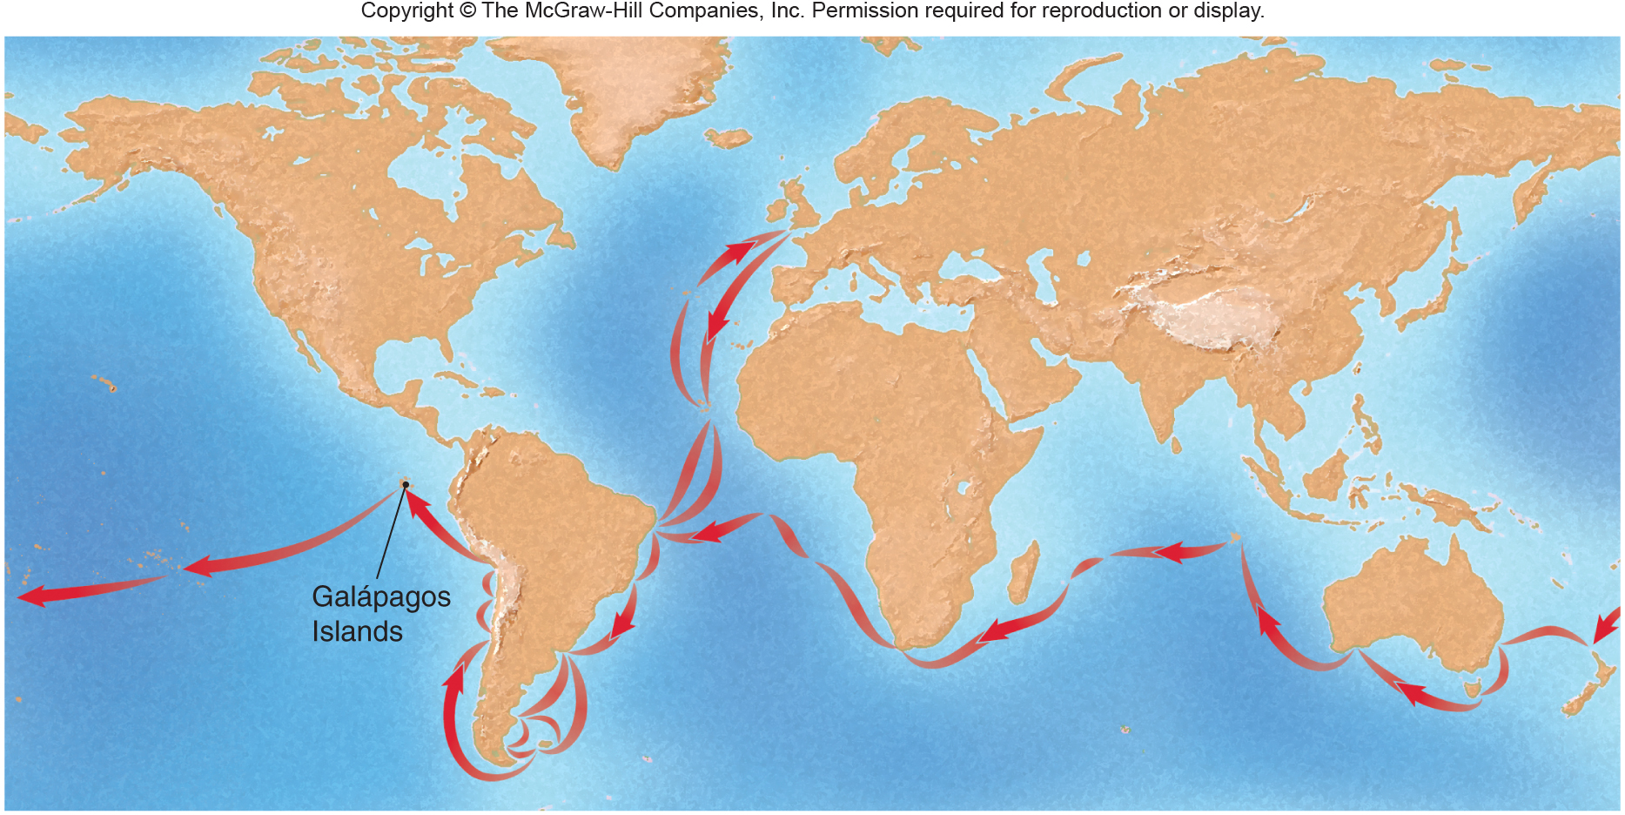
Darwin’s travels
1. He travelled to different but adjacent continents. (including many islands)

Slide 36
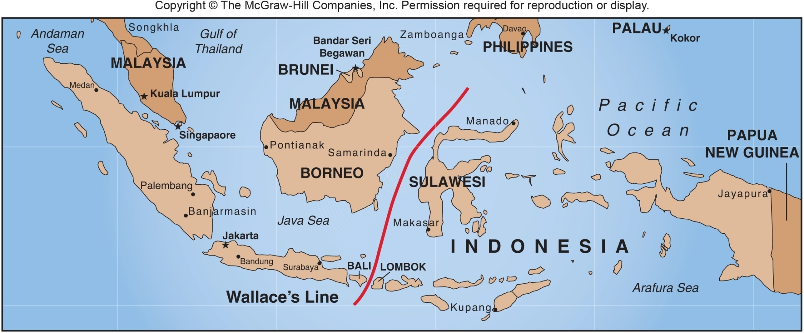
Fig. 14.11
Wallace’s travels

Slide 37
Both observed and collected lots of samples of living things and looked at the remains of dead things in the form of fossils.
They noted common features in birds, reptiles, mammals, sea creatures, like molluscs

Slide 38
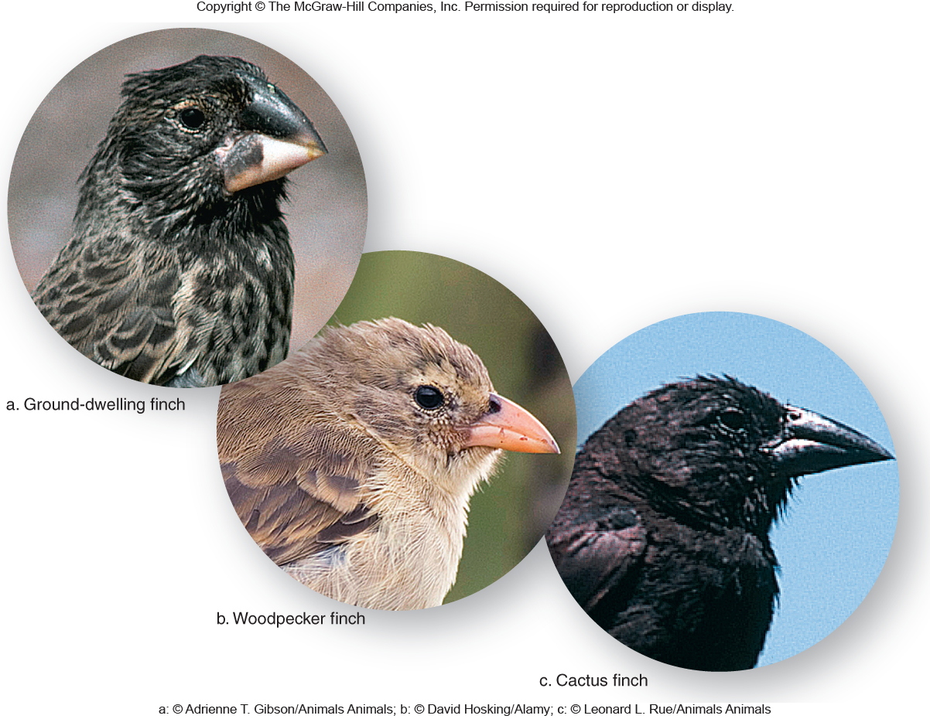
Fig. 14.6

Slide 39
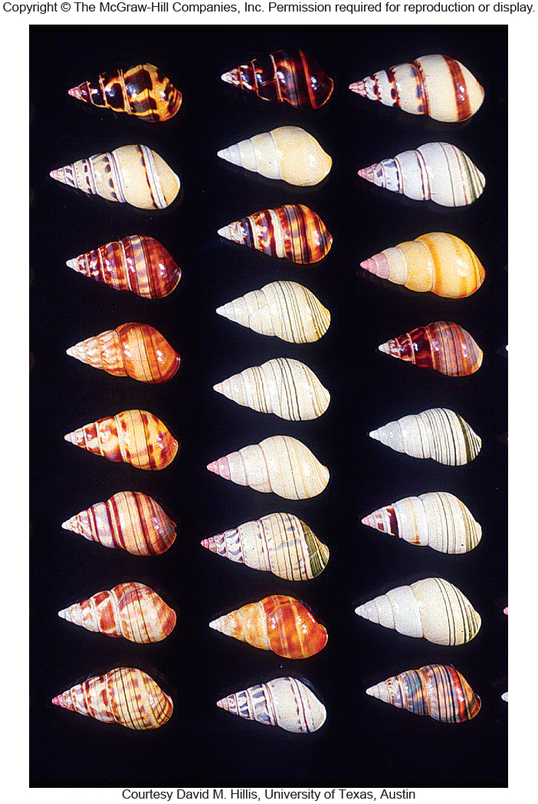
Fig. 14.7

Slide 40
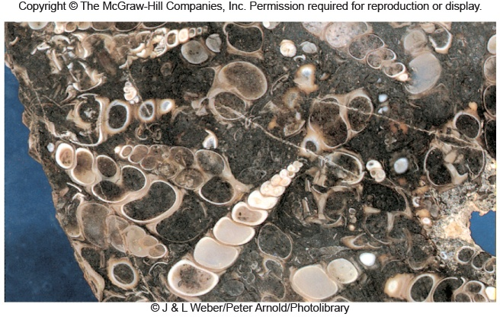
Fig. 14.3b

Slide 41
They both considered that the earth was old and that different organisms developed throughout the history of the earth (after all--- they found evidence in fossils)
No one could deny that the remains of living things were represented in these fossils

Slide 42
Darwin and Wallace actually shared their ideas about how species came to be. Darwin was amazed that someone had the same hypotheses as he did.

Slide 43
The basic idea…of Wallace and Darwin.
Every new species has come from a pre-existing one that existed in both the same physical space and time.
The further away in space and time, the less living things resemble each other.

Slide 44
How do they explain the gradual changes and the existence of so many species?
At term Wallace called “survival of the fittest”
At term Darwin called “natural selection”

Slide 45
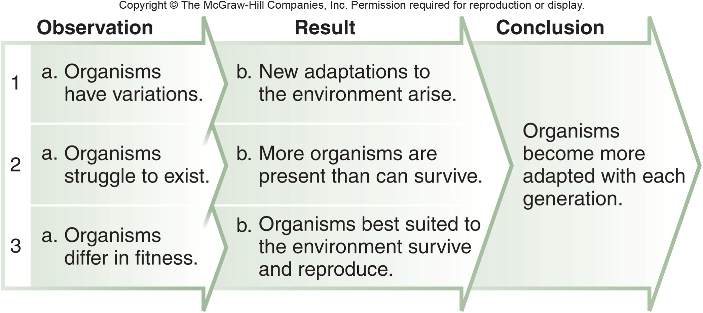
Page 247

Slide 46
The absolutely essential detail is that the variation comes from genes (different alleles) and that the “fittest” individuals pass those useful alleles on to offspring.

